Slide 1
APPLICATION SUBMITTED
By Dominique Villasenor & Niki Sinclair
An Analysis on University of California
Admissions Data

Slide 2
Have you seen the documentary “The College Admissions Scandal” on Netflix?
Having both seen this documentary, we were interested in rise in collegiate admission competition as well as the relationship between socioeconomic privilege as it relates to application, acceptance, and enrollment into the UC system.

Slide 3

How did we explore these interests using data?
We looked at general application, acceptance, and enrollment trends into the UC system over the last 5 years and drilled down on the top 10 and bottom 10 schools in each category.

Slide 4
What defines educational success?
We wanted to know which high schools applied more, and which high schools applied less into the UC system to look at educational disparities.
12th
Application period
K – 11th
11th
Educational foundation
Turning point: thinking about college
Beyond
…

Slide 5
Project Objective
These are the questions we sought to answer
# ?
# ?
How do UC application rates compare year-by-year for the last 5 years?
What are the application, admission, and enrollment rates for the highest-applying high schools?
# ?
# ?
How do UC admissions and enrollment rates compare year-by-year for the last 5 years?
What are the application, admission, and enrollment rates for the lowest-applying high schools?

Slide 6
HYPOTHESIS
We theorized the following results for our data analysis:
General application rates hypotheses
We hypothesized application rates would go down for application year of 2020 into the UC system due to COVID-19
Prior to 2020, we hypothesized application rates would increase year over year due to the general cultural shift towards favoring a college degree from reputable institutions such as UC’s • This cultural shift may be due to increased job competition, attempts to qualify for a higher-paying job, and general social norms and expectations around getting a college degree
Case studies hypotheses
We hypothesized high schools in lower-income counties would have less applications, admissions, and enrollments into the UC system
Conversely, we hypothesized high schools in higher-income counties would have more applications, admissions, and enrollments into the UC system

Slide 7
Data Sources
We weren’t able to answer all the questions about college acceptance rates with the limited data we had, but we were able to piece together admissions data over the last five years using the University of California data available to the public.
https://www.universityofcalifornia.edu/infocenter/admissions-source-school
We also used Census data to determine median income for California counties in our Top and Bottom High Schools Analysis, to test our hypothesis about educational disparities.
https://www.indexmundi.com/facts/united-states/quick-facts/california/median-household-income#table

Slide 8
Variables
Acceptance
Enrollment
Application
We looked at count of application from California high schools*
We looked at count of acceptance from California high schools*
We looked at count of enrollment from California high schools*
*Using public data from the UC System Admissions by Source School, application years of 2016 - 2020

Slide 9
Process and Tools
Process
Tools
Importing University of California admissions data from the past 5 years
Data cleaning using pandas
Data analysis using pandas charts
Case studies
Python / Jupyter Notebooks
pandas
matplotlib

Slide 10
*
UC APPLICANT TRENDS
Exploring application, admission, and enrollment trends
2016 - 2020

Slide 11
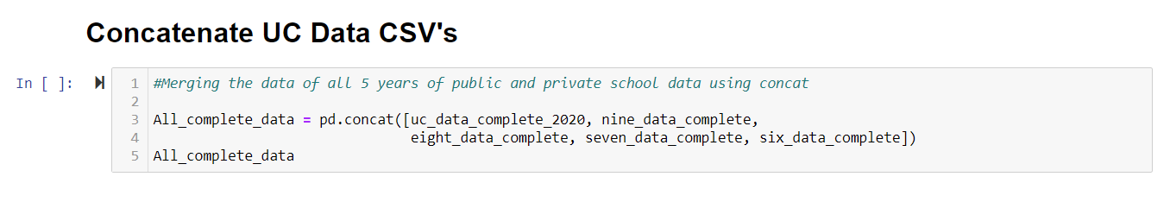
Snippet - Concat
Concatenating 10 CSV files – 2 for the last 5 applicant years (split into 2 CSVs Public/Private)

Slide 12
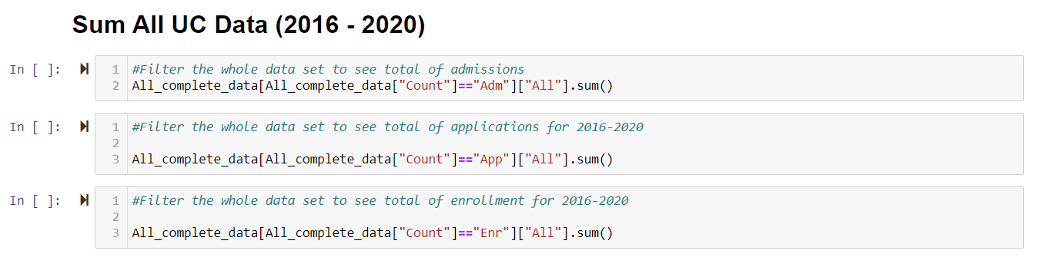
Snippet – Sum
Summing all UC Data from 2016 – 2020 for applied, admitted, and enrolled high school students (public & private)

Slide 13
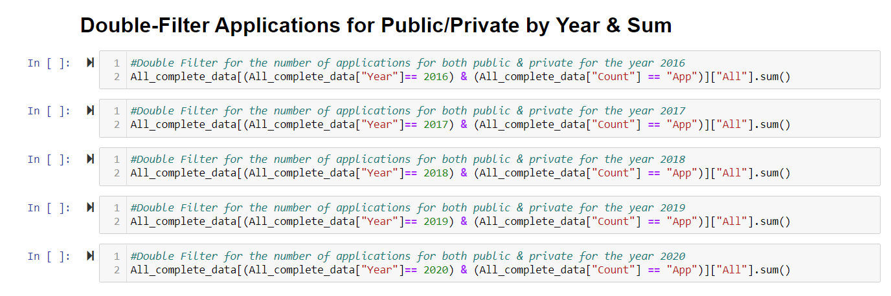
Snippet – Double Filter
Double-filtering applications for public + private high schools, 2016 – 2020
(completed same process for admissions & enrollment)

Slide 14
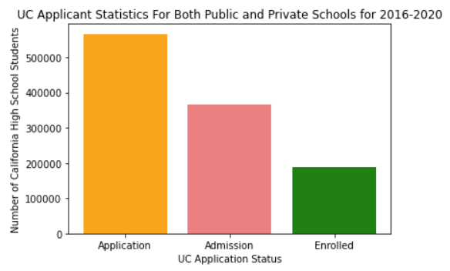
Summary Stats
Applied
Is the highest count – of course!
Admitted
Enrolled
Overall UC acceptance rate is surprisingly over 50% of applied.
Overall enrollment rate into the UC system was just over 50% of admitted.

Slide 15
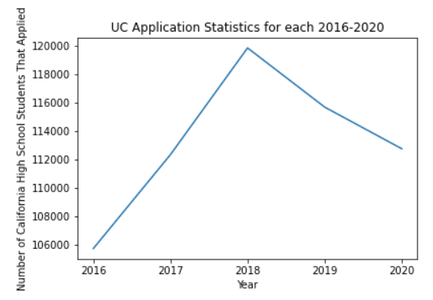
Applicant Trend
The application rate (from CA public + private high schools) trended upward, peaked at 2018, and declined from 2019 - 2020

Slide 16
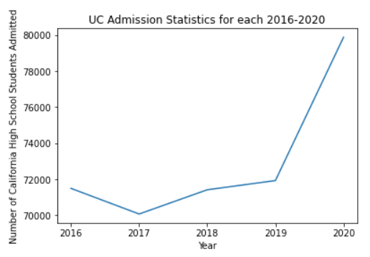
Admitted Trend
The admissions rate (from CA public + private high schools) greatly rose from 2019 – 2020
(this could be due to COVID!)

Slide 17
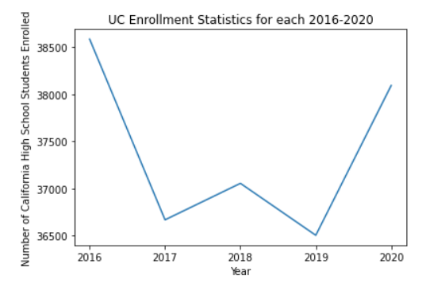
Enrollment Trend
The enrollment trend is more varied, though we can deduce that from 2016 – 2019, high school students may have been exploring other options outside of the UC system or otherwise.

Slide 18
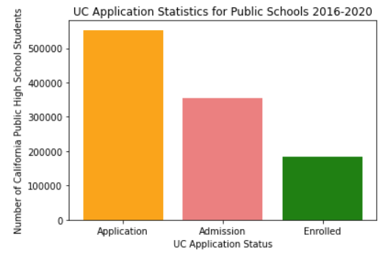
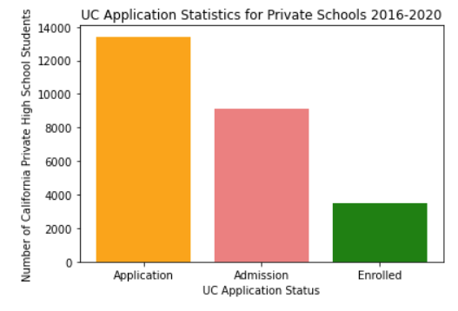
Public v. Private
While the stats for applied, admitted, and enrolled were similar between public and private high schools, private schools had a slight advantage in admission at 68%, while public school admission was at 64% (over the last 5 years).

Slide 19
*
CASE STUDIES ANALYSIS
Exploring Top 10 and Bottom 10 high schools for application, admission, and enrollment
2016 - 2020

Slide 20
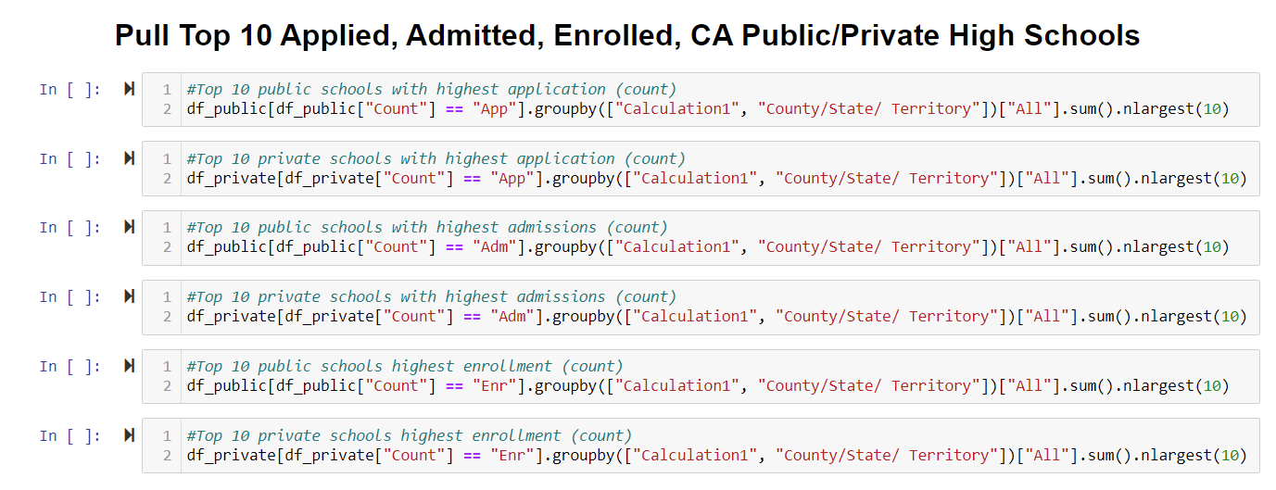
Snippet – Group By
Group by largest to filter top 10 public/private high schools by applied, admitted, enrolled count
(Completed same process for bottom 10 using .nsmallest)

Slide 21
Top 10 Applications
Top 10 Public
Top 10 Private
For the Top 10 public high schools with the highest count of applications, there were 3 schools under the California average median income
For the Top 10 private high schools with the highest count of applications, there was 1 school under the California average median income

Slide 22
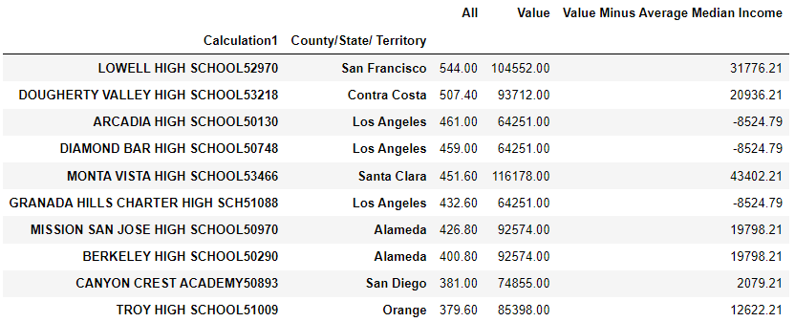
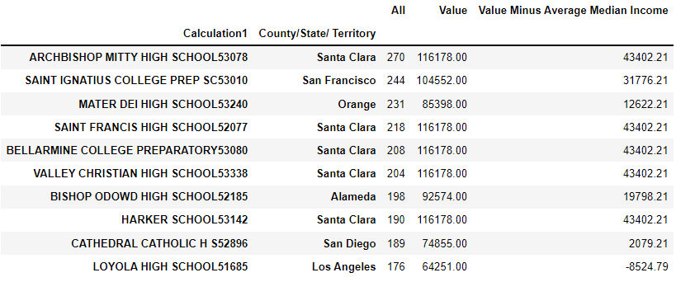
Top 10 Applications – Public vs. Private High Schools
Public
Private

Slide 23
Bottom 10 Applications
Bottom 10 Public
Bottom 10 Private
For the Bottom 10 public high schools with the lowest count of applications, there were 4 schools under the California average median income
For the Bottom 10 private high schools with the lowest count of applications, there were 8 schools under the California average median income

Slide 24
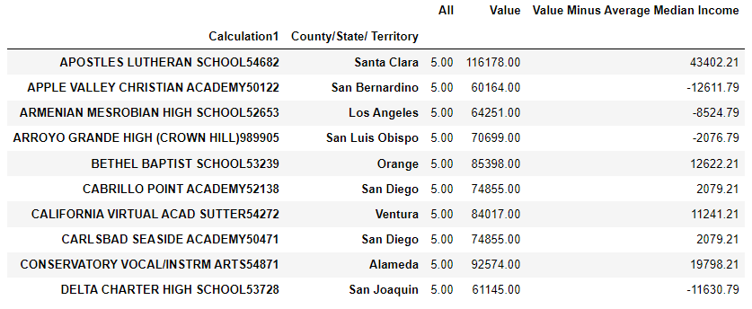
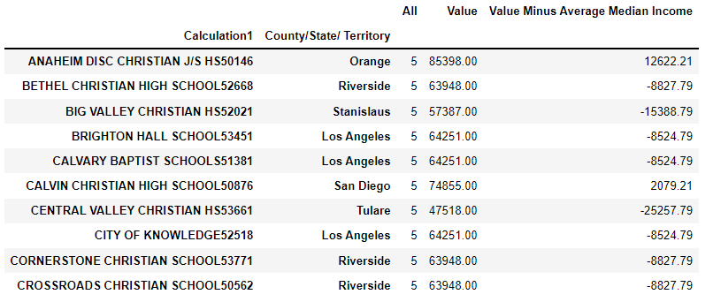
Bottom 10 Applications – Public vs. Private High Schools
Public
Private

Slide 25
Top 10 Admissions
Top 10 Public
Top 10 Private
For the Top 10 public high schools with the highest count of admissions, there were 2 schools under the California average median income
For the Top 10 private high schools with the highest count of admissions, there were 0 schools under the California average median income

Slide 26
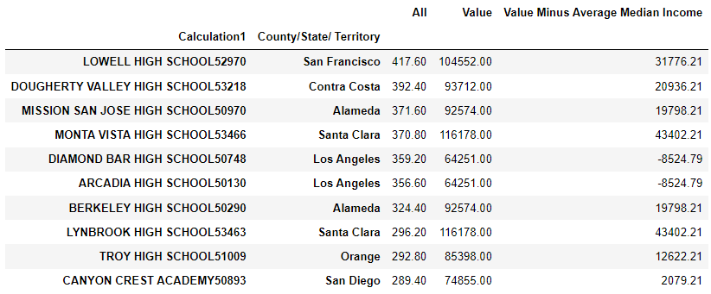
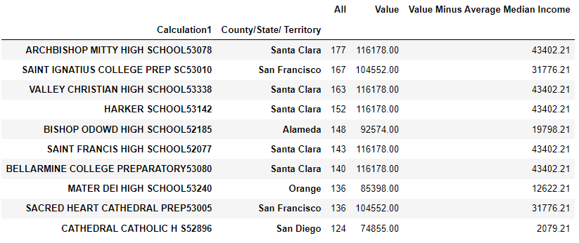
Top 10 Admissions – Public vs. Private High Schools
Public
Private

Slide 27
Bottom 10 Admissions
Bottom 10 Public
Bottom 10 Private
For the Bottom 10 public high schools with the lowest count of admissions, there were 5 schools under the California average median income
For the Bottom 10 private high schools with the lowest count of admissions, there were 5 schools under the California average median income

Slide 28
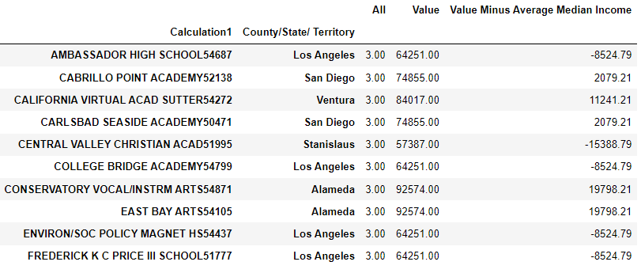
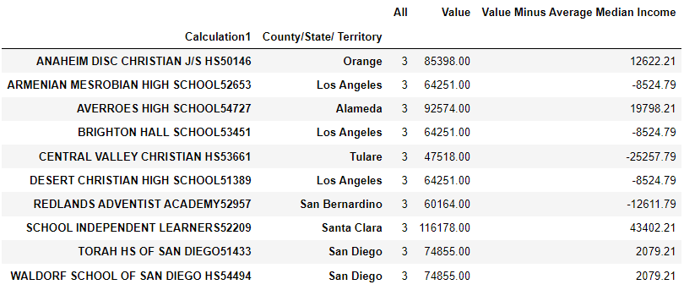
Bottom 10 Admissions – Public vs. Private High Schools
Public
Private

Slide 29
Top 10 Enrollment
Top 10 Public
Top 10 Private
For the Top 10 public high schools with the highest count of enrollment, there were 3 schools under the California average median income
For the Top 10 private high schools with the highest count of enrollment, there were 1 schools under the California average median income

Slide 30
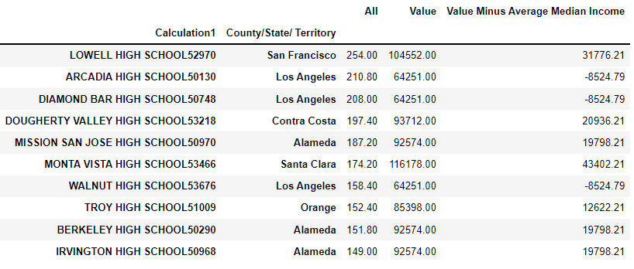
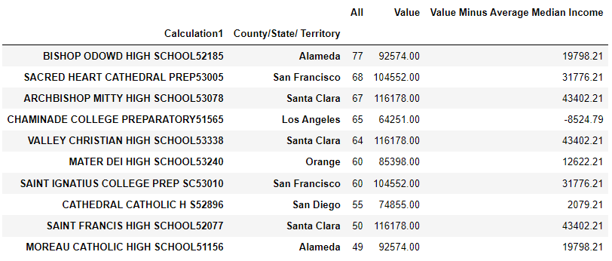
Top 10 Enrollment – Public vs. Private High Schools
Public
Private

Slide 31
Bottom 10 Enrollment
Bottom 10 Public
Bottom 10 Private
For the Bottom 10 public high schools with the lowest count of enrollment, there were 7 schools under the California average median income
For the Bottom 10 private high schools with the lowest count of enrollment, there were 4 schools under the California average median income

Slide 32
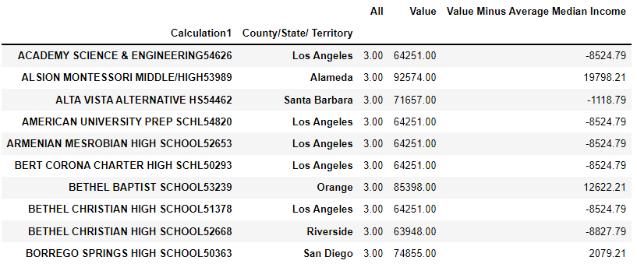
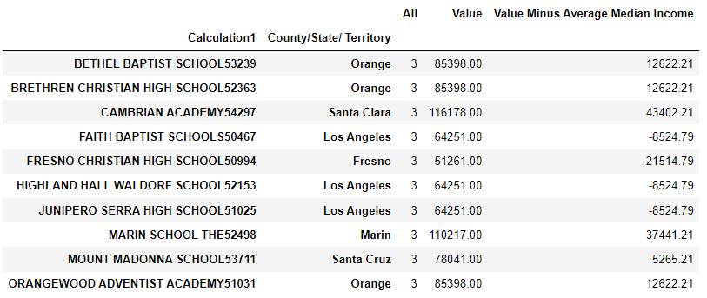
Bottom 10 Enrollment – Public vs. Private High Schools
Public
Private

Slide 33
Case Studies Analysis
Top 10 Public/Private High Schools – Applied, Admitted, and Enrolled
Top Public High Schools – had as many as 3 schools that were below the CA median income
Top Private High Schools – had as many as 1 school that was below the CA median income
Bottom Public High Schools – had as many as 7 schools that were below the CA median income
Bottom Private High Schools – had as many as 8 schools that were below the CA median income

Slide 34
Did we prove our hypothesis?
1. TRUE
3. TRUE
Application rates into the UC system did decrease in 2020
The top 10 most applied, admitted, and enrolled CA high schools were more likely to be in counties over the average median income
2. PARTLY TRUE
4. TRUE
Application rates did increase from 2016 – 2018, but decreased in 2019 – 2020
The bottom 10 least applied, admitted, and enrolled CA high schools were more likely to be in counties below the average median income

Slide 35
We found out late into our project that the UC data omits any schools with less than 5 applicants, and less than 3 admitted. Therefore, there were rows missing from our data set that would have provided a more complete analysis rather than leaving students out.
We made do using the data we had to still paint a (mostly) clear picture of California high school student application, admission, and enrollment trends.
Data Pitfall

Slide 36
Further Research
Data Exploration
If we had the student body count, we could have further explored educational disparities by comparing the applicant count to the student body count
While overall admitted rate into the UC system was over 50%, we could have further explored admission rate by campus.
At first, were interested in students’ graduating majors as well as linking it to gender. However, we found that the UC data was not gender-inclusive. But this would be something interesting to analyze in the future with better data.

Slide 37
*
THANK YOU

